Slide 1


Slide 2
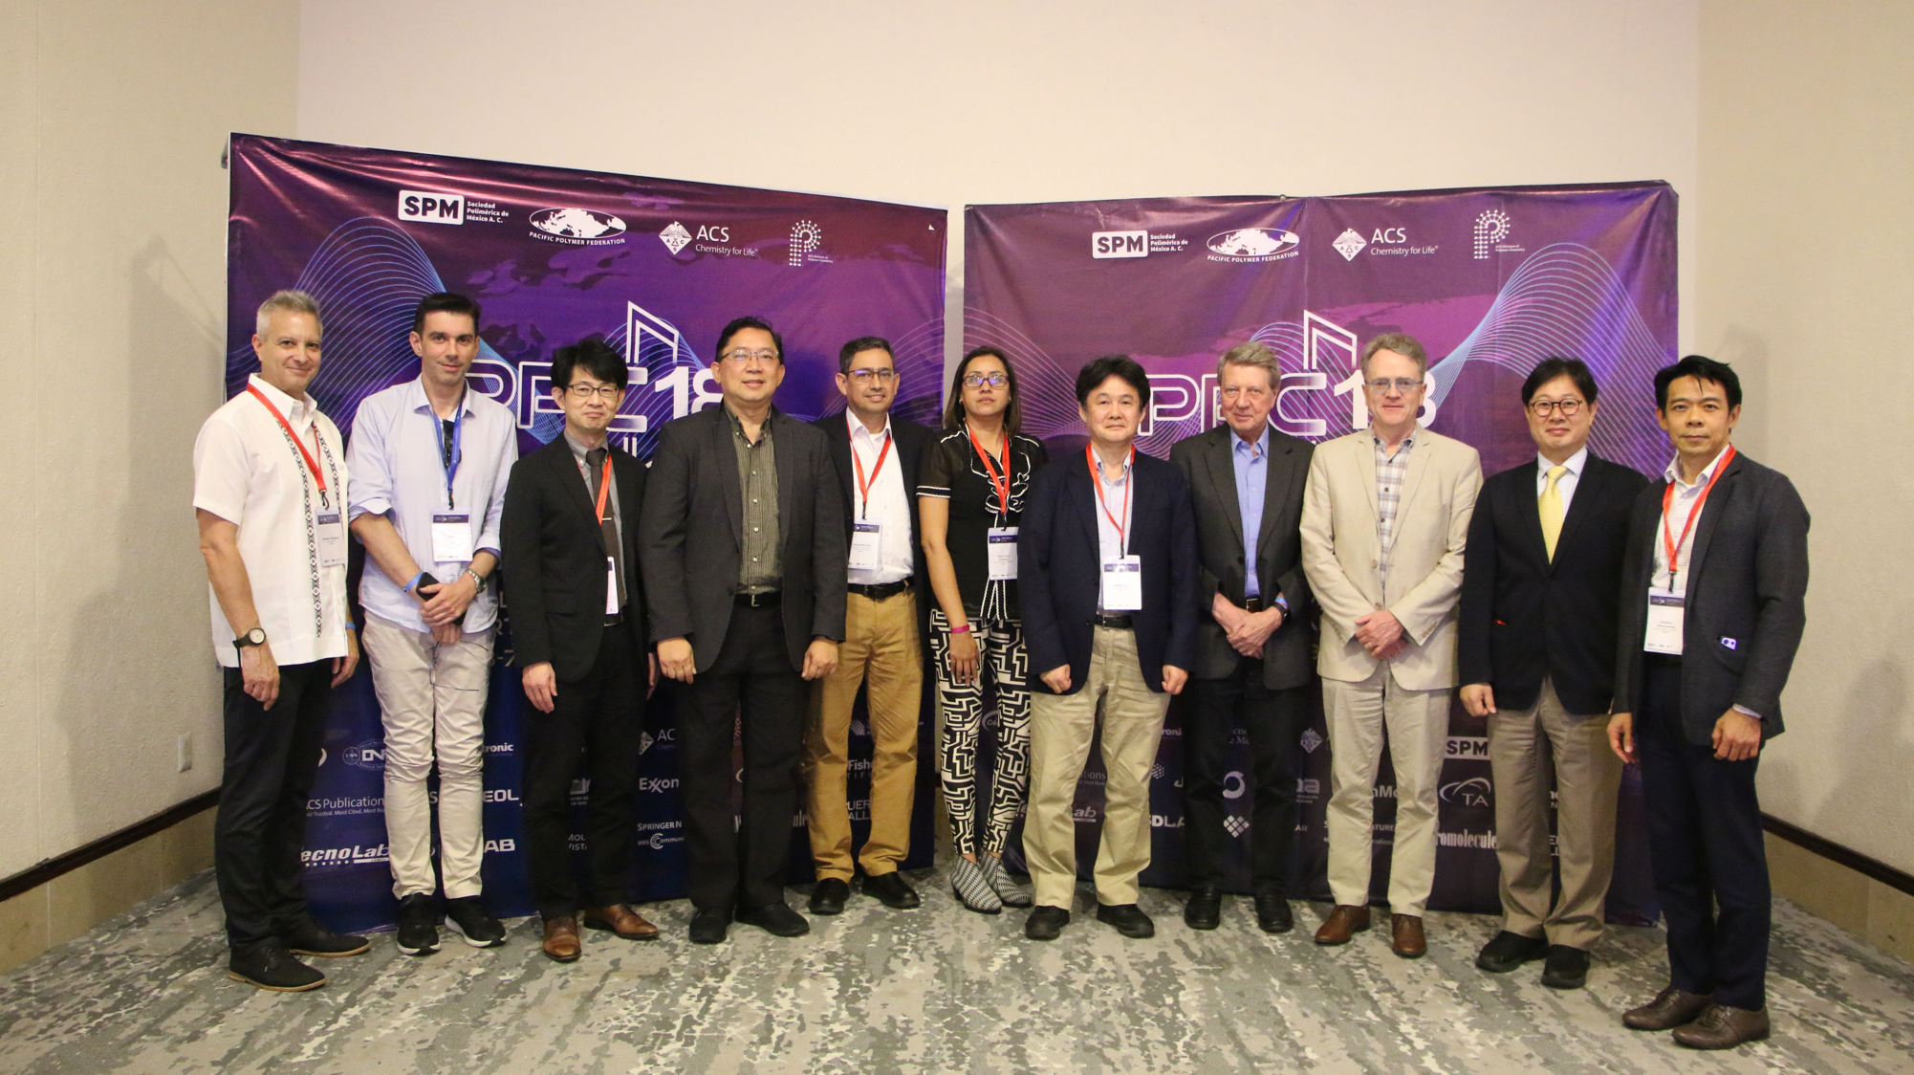

Slide 3
Agenda of the PPF Council Meeting
December 4th, 2023. 7:30 pm
Ceiba Room – Sheraton Buganvilias Convention Center
1.- Opening and Welcome Greetings
2.- Introduction of Council Members
3.- Report on PPC-18
4.- Presentation on PPC-19 (2025, Prof. Keiji Tanaka)
5.- Presentation on PPC-20 (2027, Prof. Done June Ahn)
6.- Presentation Proposal PPC-21 (2029, Prof. Mike Cunningham)
7.- Election on President, Vice President and Secretary-Treasure of PPF 2025
8.- Other issues related to PPF or PPC (Permanent Secretary in Singapore – Prof. Mathew Hu)
9.- Next Council Meeting
10.- Closing and Remarks.
Chair: Prof. José Bonilla-Cruz
Chair: Prof. Rigoberto Advíncula

Slide 4
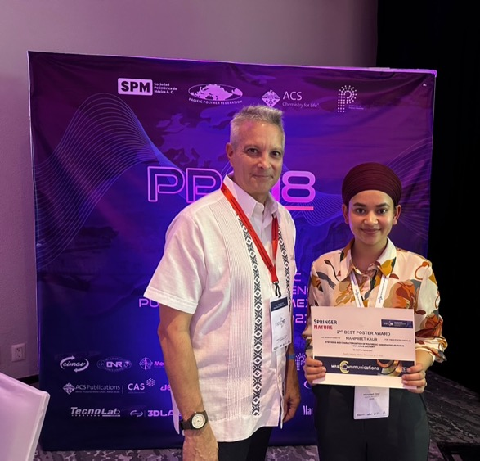
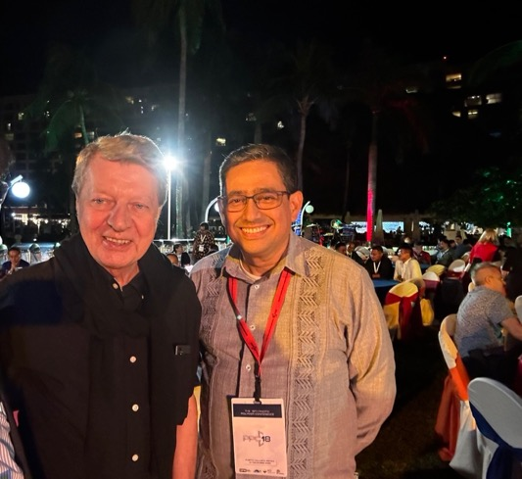
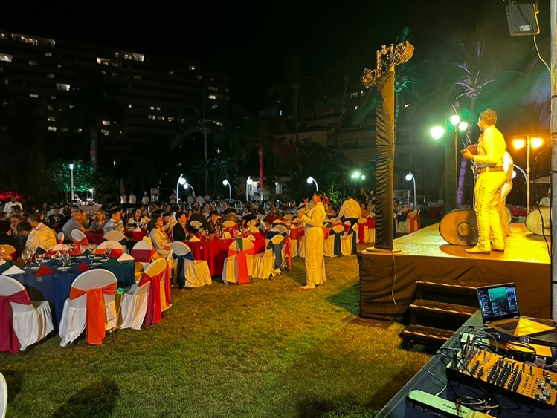

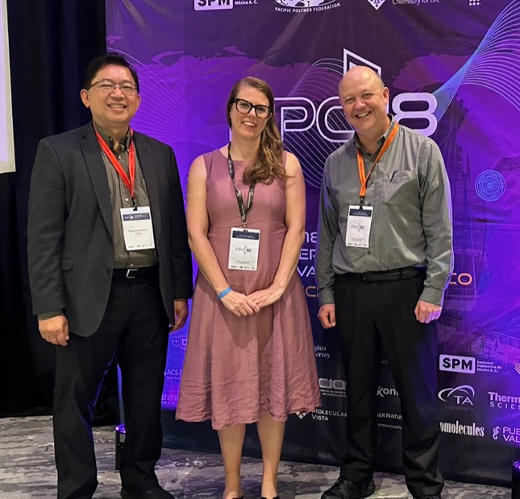
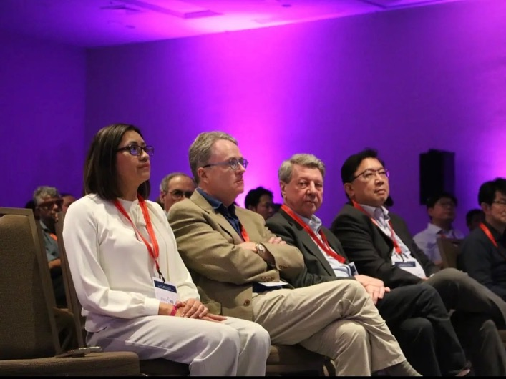
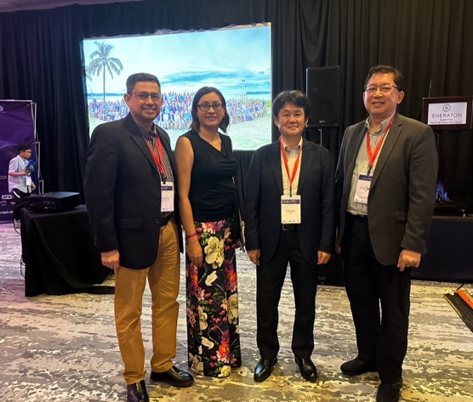

Slide 5
PPC 18
Pais | Abstracts | Attendees
Mexico | 138 | 72
United States | 94 | 67
China | 27 | 16
Japan | 19 | 14
Australia | 12 | 6
Canada | 12 | 8
Korea | 7 | 8
South Korea | 7 | 5
Chile | 6 | 2
France | 3 | 2
Brazil | 2 | 1
Spain | 2 | 2
Thailand | 2 | 1
Belgium | 1 | 1
Ecuador | 1 | 1
India | 1 | 0
New Zealand | 1 | 0
Singapore | 1 | 0
Sweden | 1 | 0
Switzerland | 1 | 0
Taiwan | 1 | 0
Turkey | 1 | 0
United Kingdom | 1 | 1
 | 341 | 204
Abstracts
Attendees

Slide 6
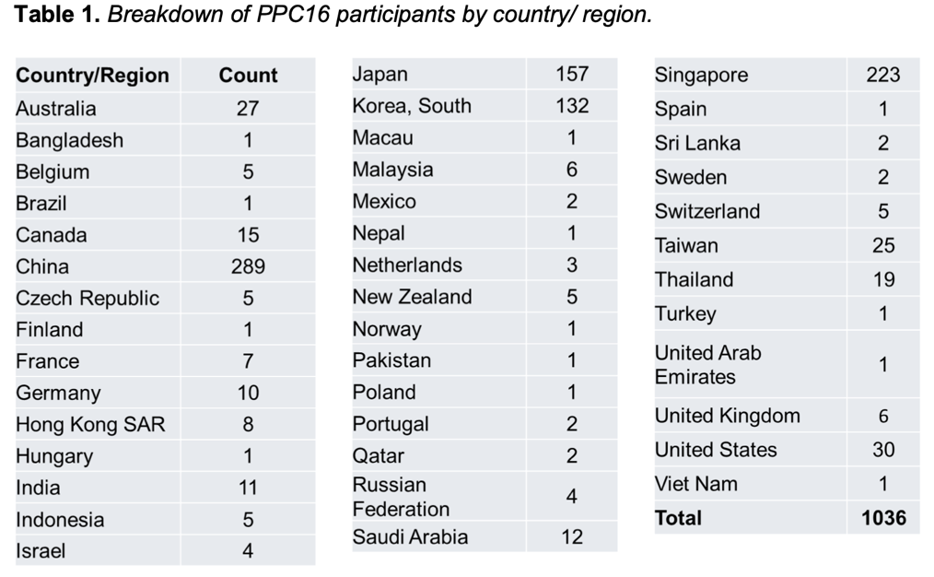
PPC17
601

Slide 7
Future Pacific Polymer Conferences (PPC) Meetings
PPC19: will be on July 6-9, 2025 tentative date for the conference at Kitakyushi City, Fukoka, Japan. To be led by Prof. Kato from University of Tokyo
PPC20: 2027 Busan, Korea
PPC 21: 2029 Vancouver, Canada

