Slide 1
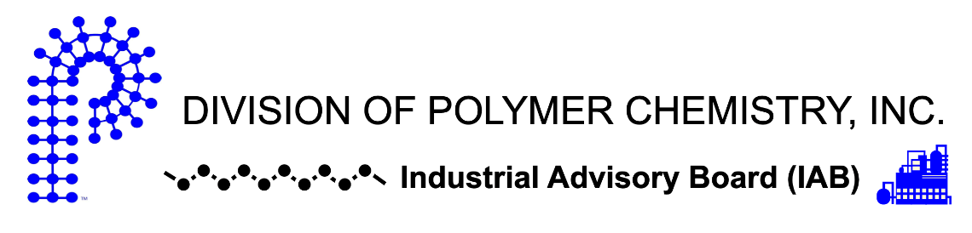
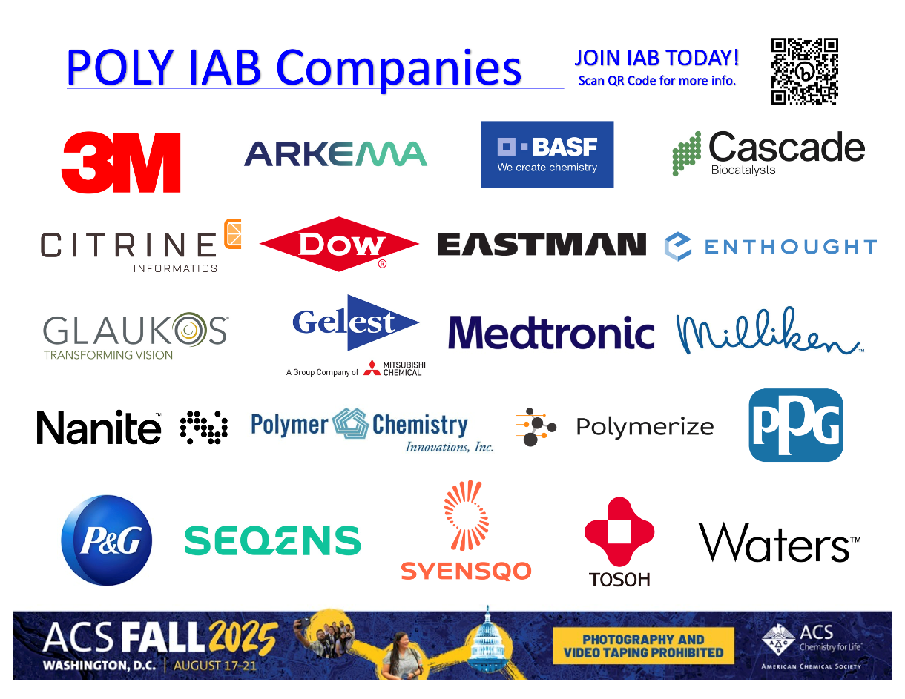
POLY Industrial Advisory Board
Annual dues: $1,500
Small company dues: $500
Chair: Jeff Ting (Nanite)
Co-Chair: Mike Sims (Syensqo)

Slide 2

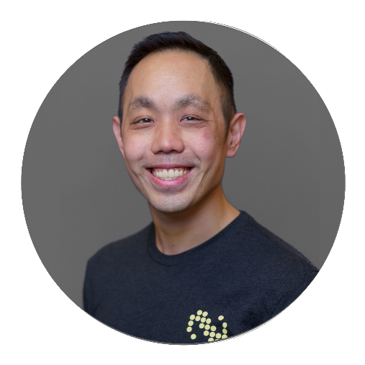
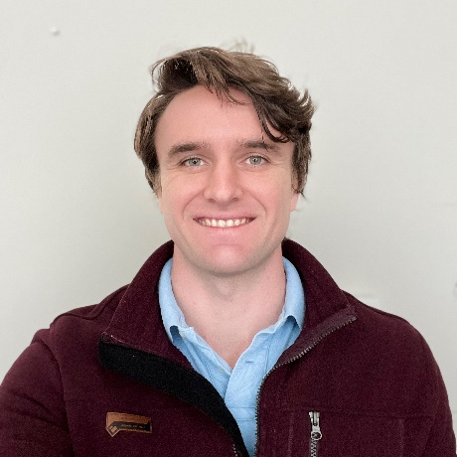
IAB Mission & Officers 2025
Chair: Jeff Ting (Nanite)
Co-Chair: Mike Sims (Syensqo)
Networking
  Monday networking hour
  Tuesday morning breakfast
Finance & Reporting
  IAB business meetings
Bulletin
Succession Planning
Industrial Awards (IPS & YIPS) Support
  POLY Awards Subcommittee Member
New Initiatives
Membership & Retainment
Programming
  Industrial Innovation in Polymer Science (IIPS)
  Other industrial programming
“Enhance and foster industrial engagement and support to develop programming, education, recognition & awards within the ACS Division of Polymer Chemistry.”

Slide 3
IAB Focuses for 2025
Maintain programming & awards support
Deliver on member company initiatives
  IAB Networking Sessions
  IAB Meetings
Integrate smaller company members
Understanding value POLY and IAB provide in long-term hybrid environment
Balance with business office changes

Slide 4
2024 IAB Budget Summary
 | Final 2024 | Proposed 2025
Income | $17,475 | $20,500
Expenses
Networking | $7522.04 | $7000.00
Meetings | $3116.67 | $5100.00
Awards | $3000.00 | $5500.00
Programming (no virtual) | $3250.00 | $1000.00
Other (shirts, pins) | $0 | $0
subtotal | $16,888.71 | $18,600.00
Bal | $586.29 | $1900.00

Slide 5


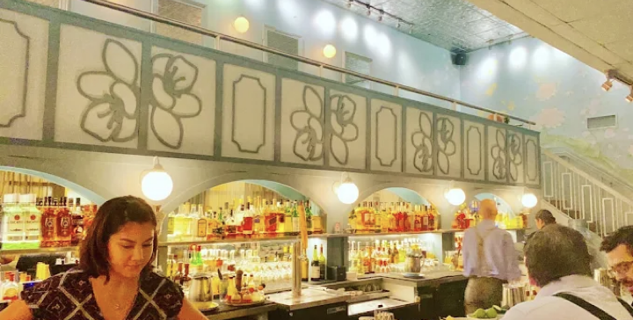
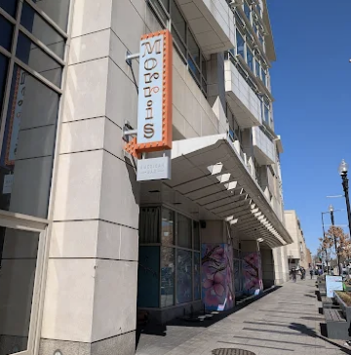



Fall 2025 Programming and Networking
Industrial Innovations in Polymer Science (IIPS) Symposium
Organizers: Michael Petr, Rohini Gupta, Manesh Sekharan
Monday, August 18th - AM Session
Hall D, Room 6
IAB Networking Reception
Monday, August 18th, 6:00-8:00 PM
Morris American Bar
1020 7th St NW, Washington DC
IAB Members, POLY ExCom Officers, and potential Industrial representatives welcome
Industrial Advisory Board Meeting
Tuesday, August 19th (café), 7:30 am
Baker’s Daughter Café & Market, 1201 K St NW, Washington DC
IAB Member Company Representatives, POLY ExCom Officers Only
The Young Industrial Polymer Scientist Award (Jeff Ting)
Organizer: Shashi Murthy
Monday, August 18th - PM Session
Hall D, Room 6
Next Generation Materials Discovery and Production
Organizer: Mike Sims
Wednesday, August 20th - AM, PM Sessions
Hall D, Room 7

Slide 6


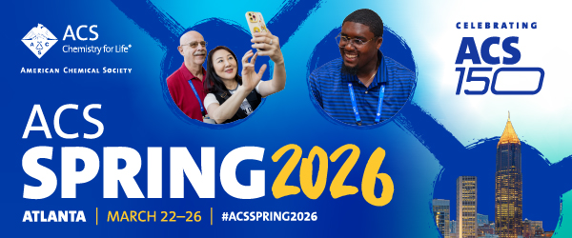

Spring 2026 Programming and Networking
Industrial Innovations in Polymer Science symposium
Organizers: Kapil Dev Sayala,
Atlanta, GA
Capturing the Power of Data for Materials and Chemical Scientists in Industry
Organizer: Michael Heiber, Alix Schmidt, Vikas Varshney, Hendrik Heinz
Atlanta, GA
Academic Entrepreneurship and Tech Transfer: Turning Research into Revenue
Organizer: Kapil Dev Sayala, Jeff Ting
IAB Networking Reception
TBD
IAB Members, POLY ExCom Officers, and potential Industrial representatives welcome
Industrial Advisory Board Meeting
TBD
IAB Member Company Representatives, POLY ExCom Officers Only
ACS Spring 2026, Atlanta GA: March 22nd - 26th

Slide 7

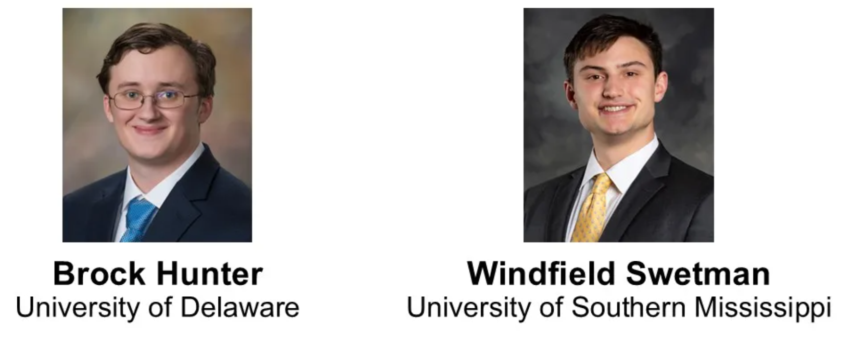
2025 POLY
Graduate Student Travel Award
Brock Hunter
University of Delaware
Windfield Swetman
University of Southern Mississippi
To provide funding for graduate students studying polymer science at
US institutions to travel to national ACS meetings and present their results

Slide 8
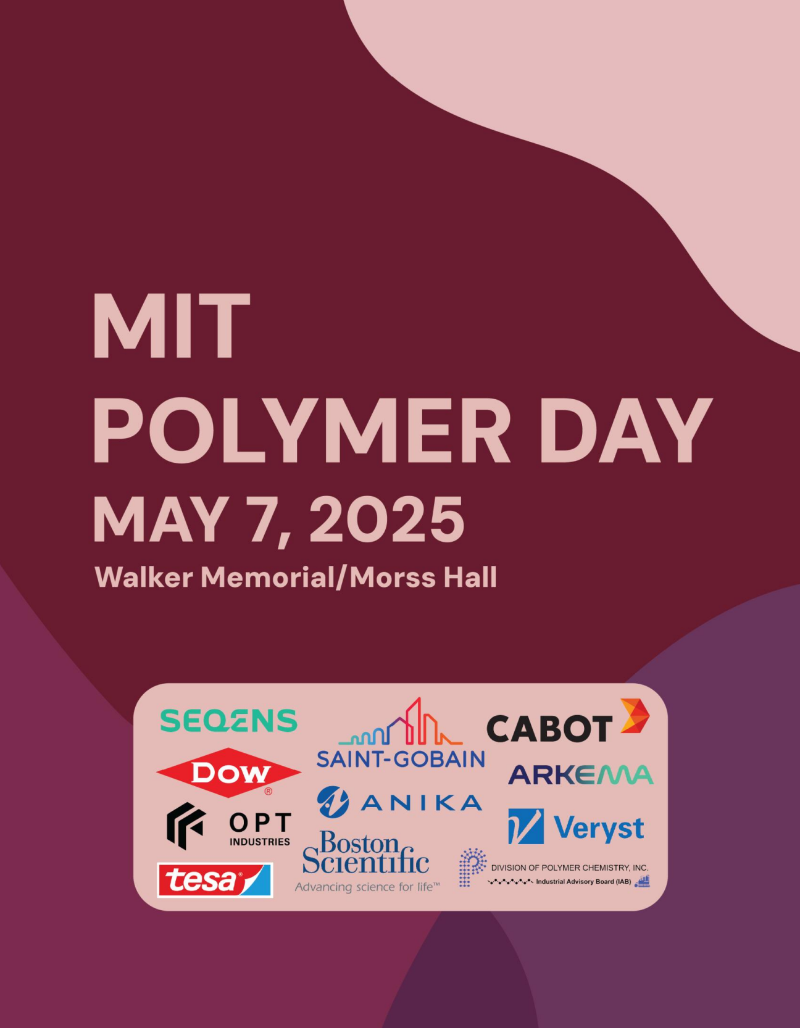
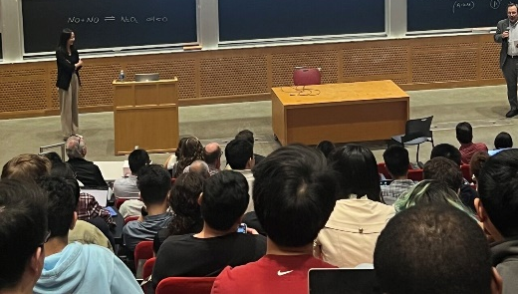
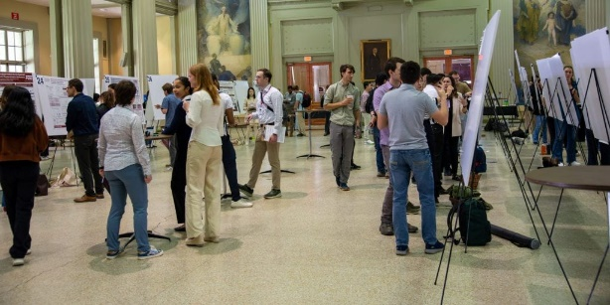
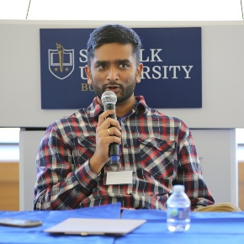
IAB Sponsored Event
MIT Polymer Day 2025
MIT Polymer Day is an annual day-long symposium to highlight the latest polymers and soft matter research from various US universities, industry professionals, and the broader polymer and soft matter science community.
IAB voted in Spring 2025 to sponsor $500 to the event
~ 300 registrants, 11 sponsors, Prof. Zhenan Bao keynote, 79 posters, 2 student seminars during the event
Covered advanced polymer applications in electronic skin, energy/consumer care, and human health
Kapil Dev Sayala
R&D Scientist, SEQENS

Slide 9
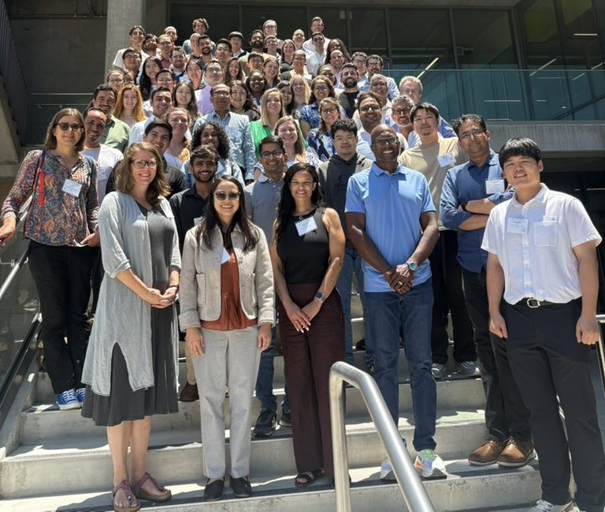
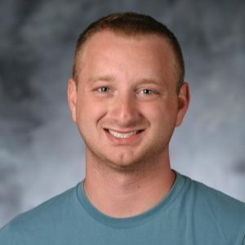
IAB Sponsored Event
2025 Future Faculty Workshop (FFW) on Soft Matter
Annual FFW workshop supported by NSF received a termination notice, but 44 mentees were invited to UC Irvine for the event on July 15-17
IAB contributed a one-time $1000 for this urgent request
Attendees were focused primarily on academic jobs but were open for any career opportunities
Faculty and attendees were very interested in industry interests and collaborations (e.g., what kind of aerospace/defense projects have Syensqo supported?)
Great networking opportunity and way to still feel connected with the polymers community
Jacob Blankenship
Research Scientist, Syensqo

Slide 10
New Initiatives in 2025
ACS Spring 2026 – Industry posters as recruitment / visibility tool
Support more polymer-based student run conferences
(U-M Macro Symposium, UMass CUMIRP events etc.)
Not limited to sponsorship but hold panel discussions in these events – having IAB members as speakers
IAB Led Workshops 2026
Internship pipelines – a document??
Expansion of members
Thought leadership, policy advocacy
A whitepaper on emerging trends, manufacturing, regulatory related etc.

Slide 11
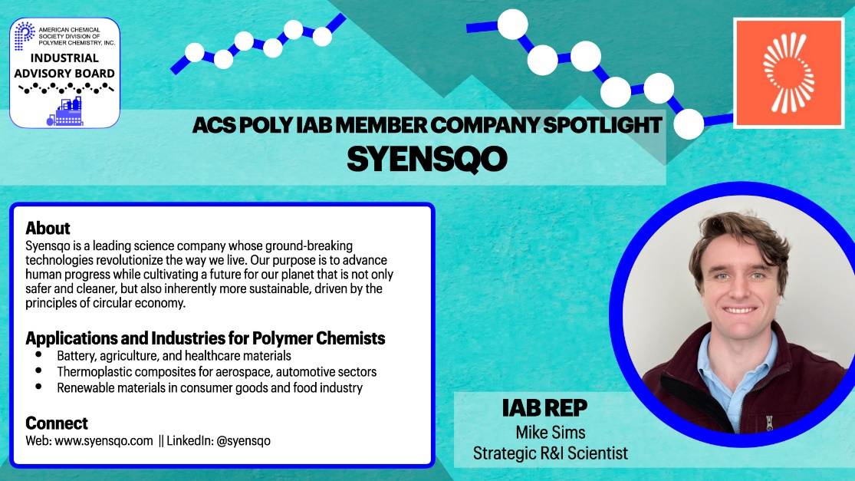
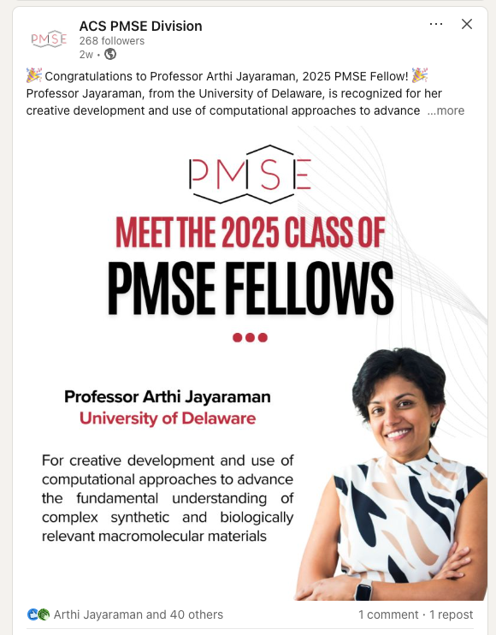
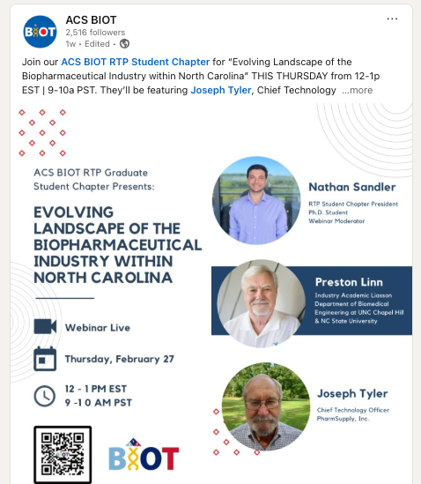
Publicity Initiative: IAB Members Spotlight
Example: Highlights company, applications/industries, and IAB representative for sharing with Network
Inspiration
Targeting specific individuals at this meeting in the POLY + PMSE industry sessions

Slide 12
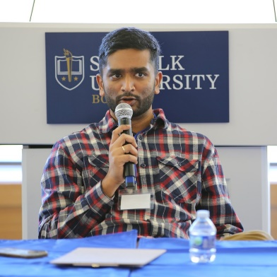
Welcome 2026 IAB Co-Chair,
Kapil Dev Sayala (R&D Scientist, SEQENS)
Expand virtual panel topics
  How to get your first industry job
  Career progression in industry
  Basics of IP/patents
Workshops at ACS meetings
  Resume building
  Interviewing/soft skills
IAB Company Posters
  Showcase at ACS POLY sessions?
Future ideas

Slide 13
Thank you
Industrial Advisory Board

